Slide 1


Team 63: Arbitrary Waveform Generator
Bi-Weekly Update 4 Leandro Bracho, Nick Joseph, Oscar Medrano, Robin Smithson Sponsor: Dr. John Lusher TA: Zhewen Hu
Notes:
Michelle

Slide 2
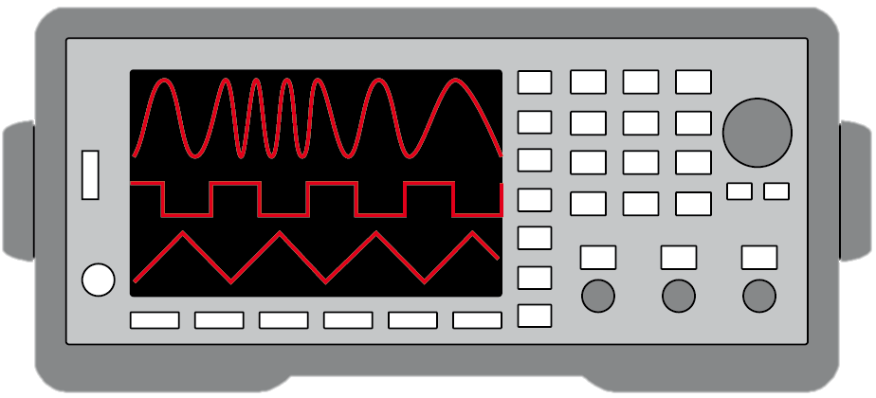
Project Summary
Problem Statement:
Test validation is a vital step in the design and fabrication of circuit boards for any project in the realm of electrical engineering.
Typical AWGs can be large and unintuitive
Solution Proposal:
Create a mobile user interface for the AWG
Bluetooth connection
Voltage range of +/- 10 V
Frequency between 1 Hz – 20 kHz
Maximum of 65,535 data points
Allow hand drawn waveforms
Notes:
Kyle

Slide 3
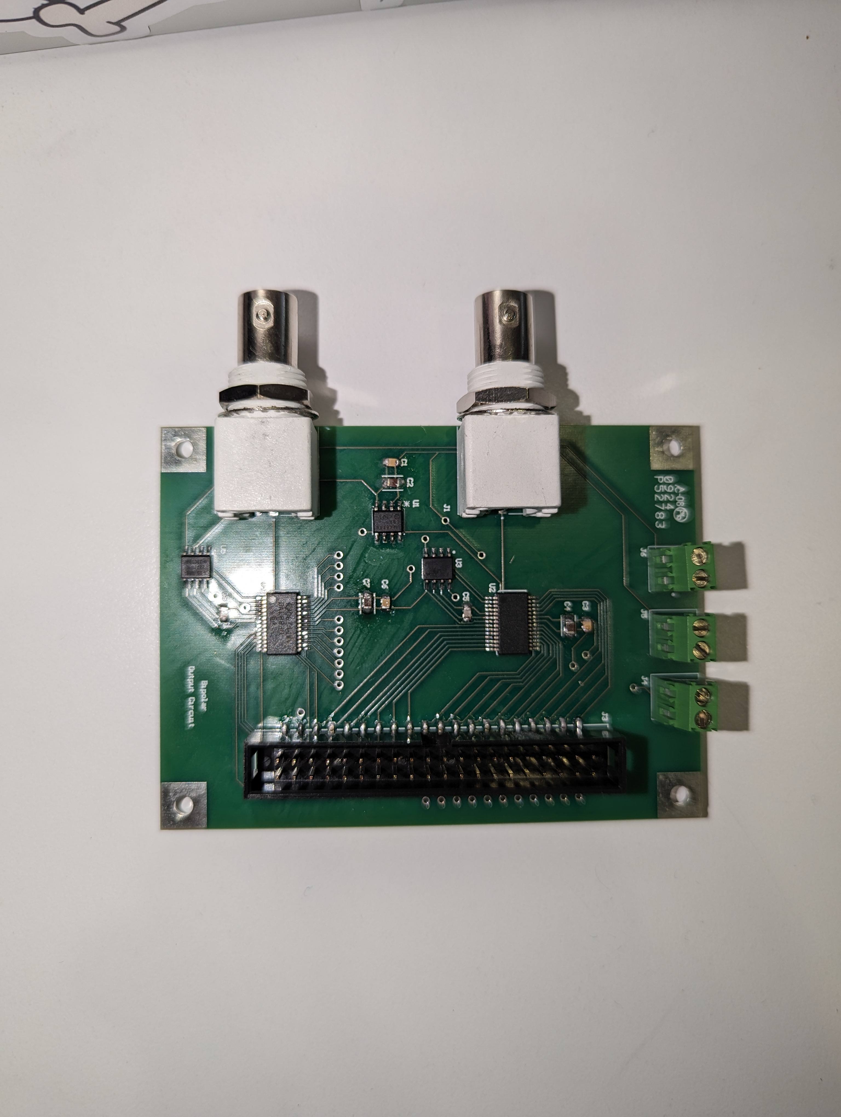
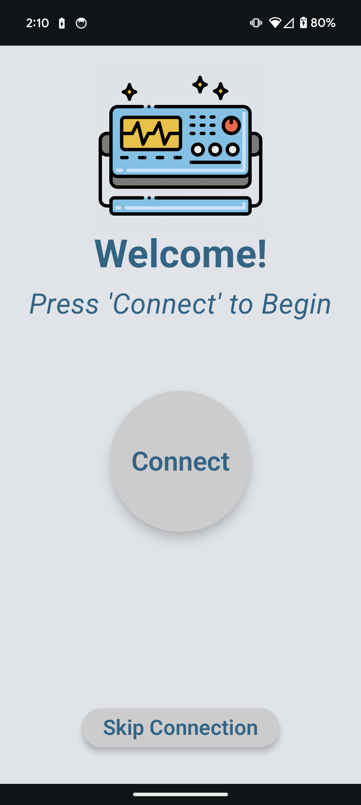
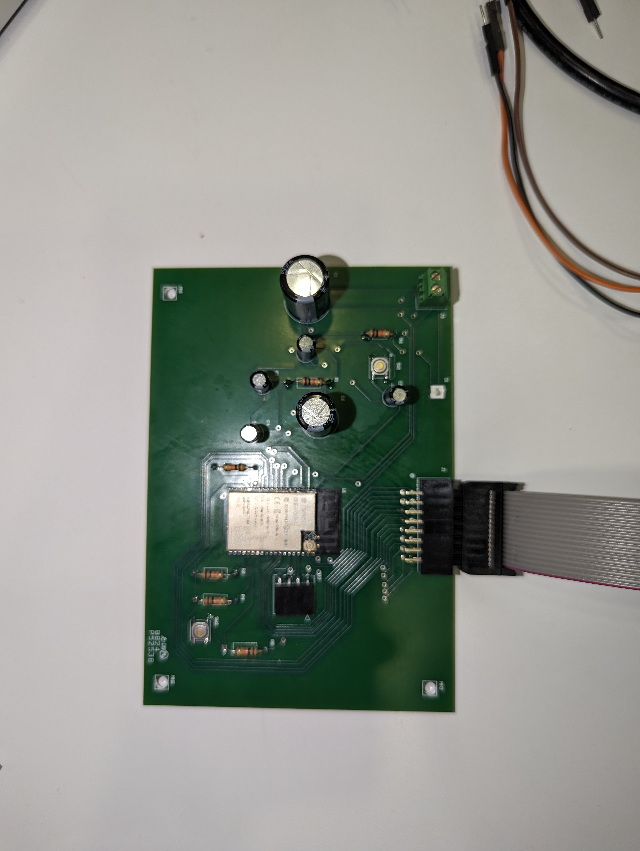

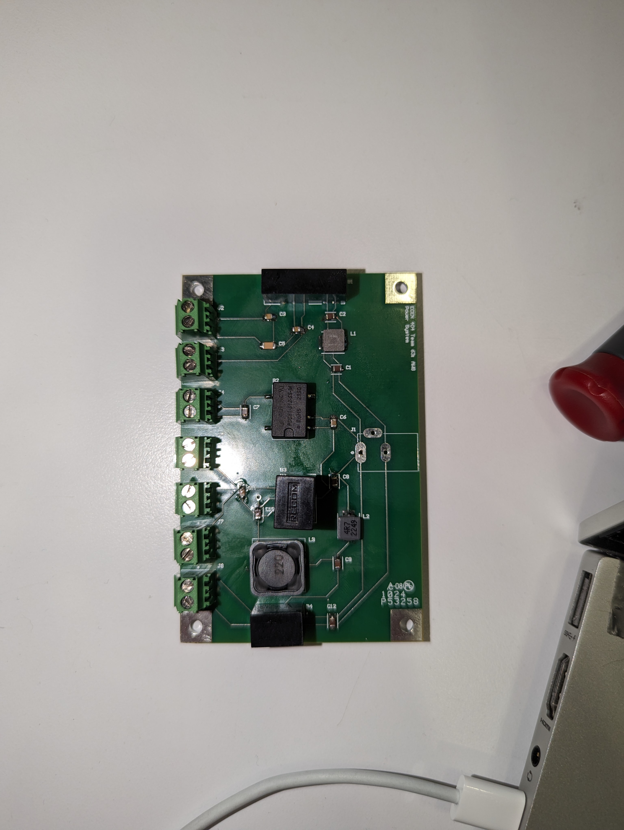

Integrated System Diagram
Front
BNC cable ports
Back
MCU -
Power jack
Notes:
(90 seconds)
NOTE this is not your usual system block diagram
This should show the complete system – with picture of packaged solution or conceptual diagram of packaged solution. Use this to describe how user interacts with system and how system interacts with external environment. Show how it connects to the outside world (communication, interfaces). If appropriate show internal breakdown and interfaces. SW projects should show data repository/db; mobile/web app connectivity; front end vs backend; and give representative screens users will see – real look-and-feel

Slide 4
Project Timeline
Update PCBs from feedback from last semester (completed 1/29) | Revalidate & Assess Subsystems (completed 2/5) | Order New PCBs (to complete by 2/16) | Integration of Bluetooth and Android App (completed 3/1) | Full Integration & System Test (to complete by 3/28) | Validation (to complete by 4/8) | Demo and Report (to complete by 4/29)
Notes:
-- Just quick overview…do not talk about work completed weeks ago, concentrate on past few weeks and upcoming activity.
-- Save detail for execution plan & validation plan status

Slide 5
Android Application
Accomplishments since last update 11 hrs of effort | Ongoing progress/problems and plans until the next presentation
Completed integration with MCU Sends 65,535 points in 7min 9sec. App can be used during data transfer. Connection status indicator Data transfer progress bar | Disconnect error message Update progress bar User sends new data
Notes:
Leandro **30 Seconds**
This should not be just subsystem status!
At this point it should be review of the System Integration and Test activities led by Team Member 1
For 4th review Accomplishments should include what integration and functional/range/error system testing completed and planned for next 2 weeks”
“Completed integration of all subsystems”
“Verified sensor data capture and communication through Bluetooth to App”
“Integrated image detection model on Pi-4 on drone, tested detection accuracy”
“Tested app error handling for stuck valve & thermal range exceeded cases”
“ON-GOING automated software testing”
“Range testing of LoRa network from 10m to 5km with 35 points in BCS”
“Rover motor stall test with 2x max payload and 40º elevation by next review”

Slide 6
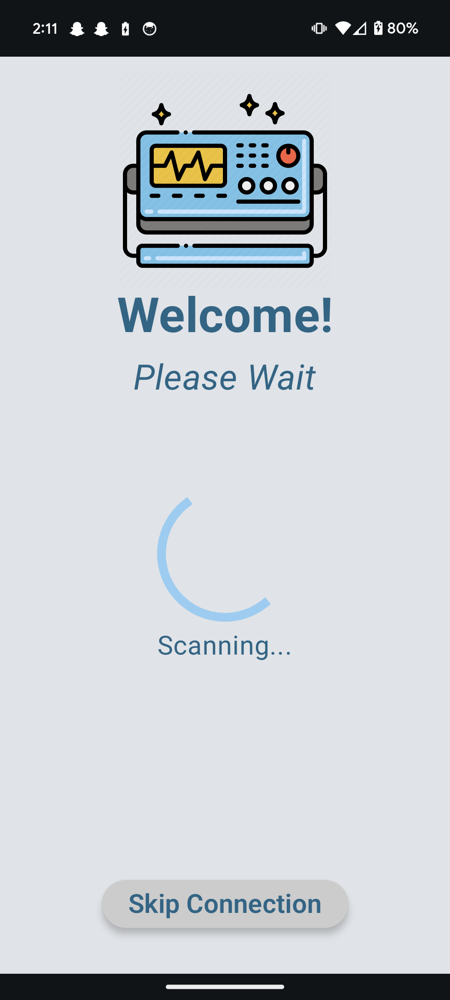
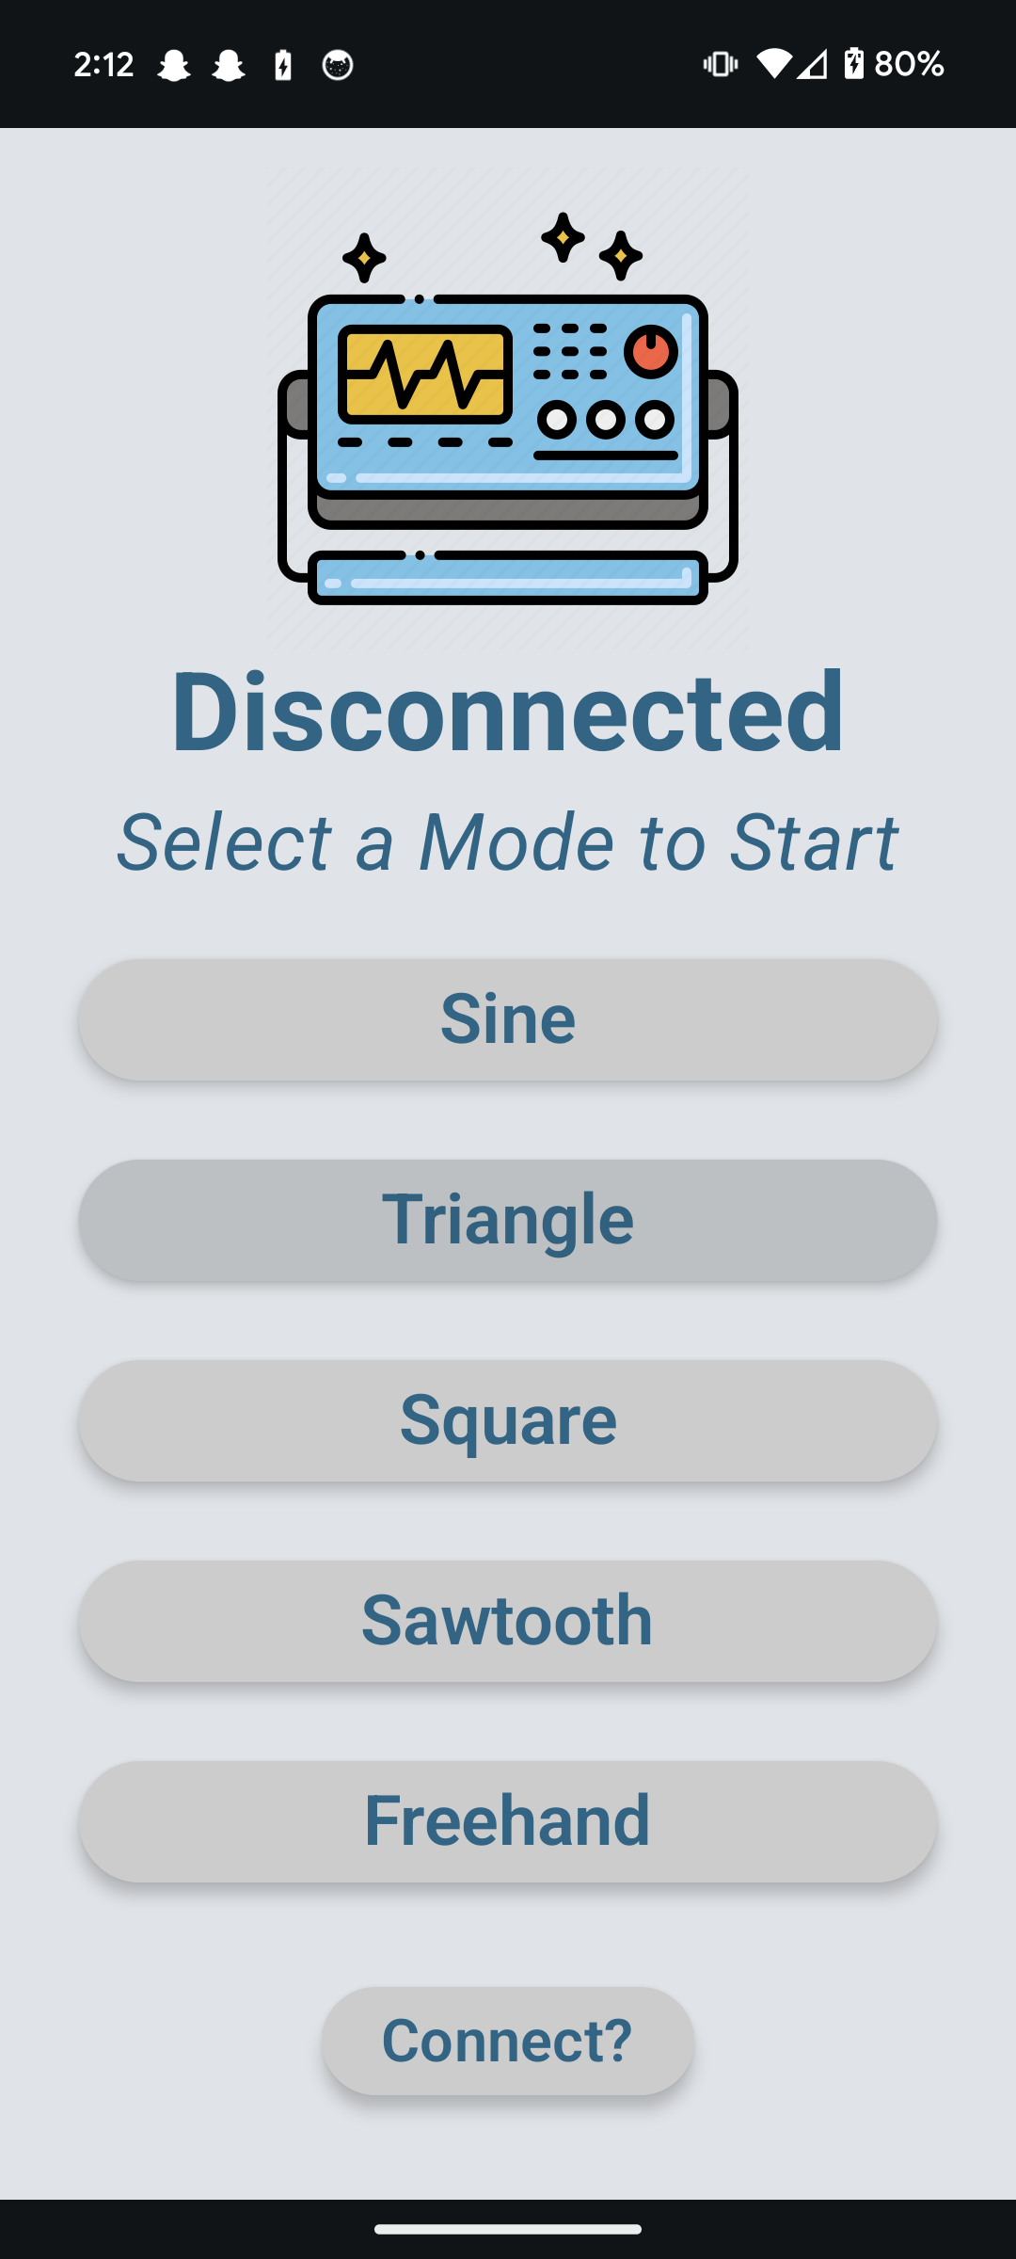
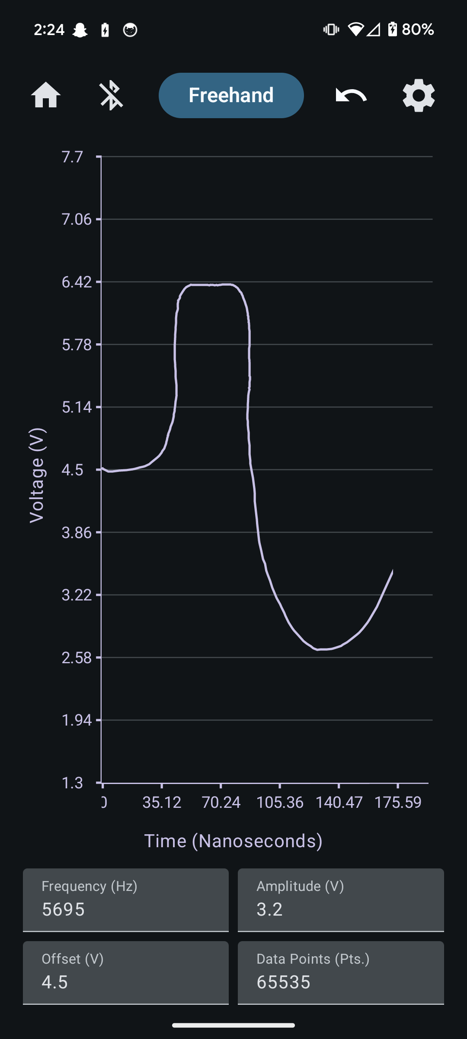
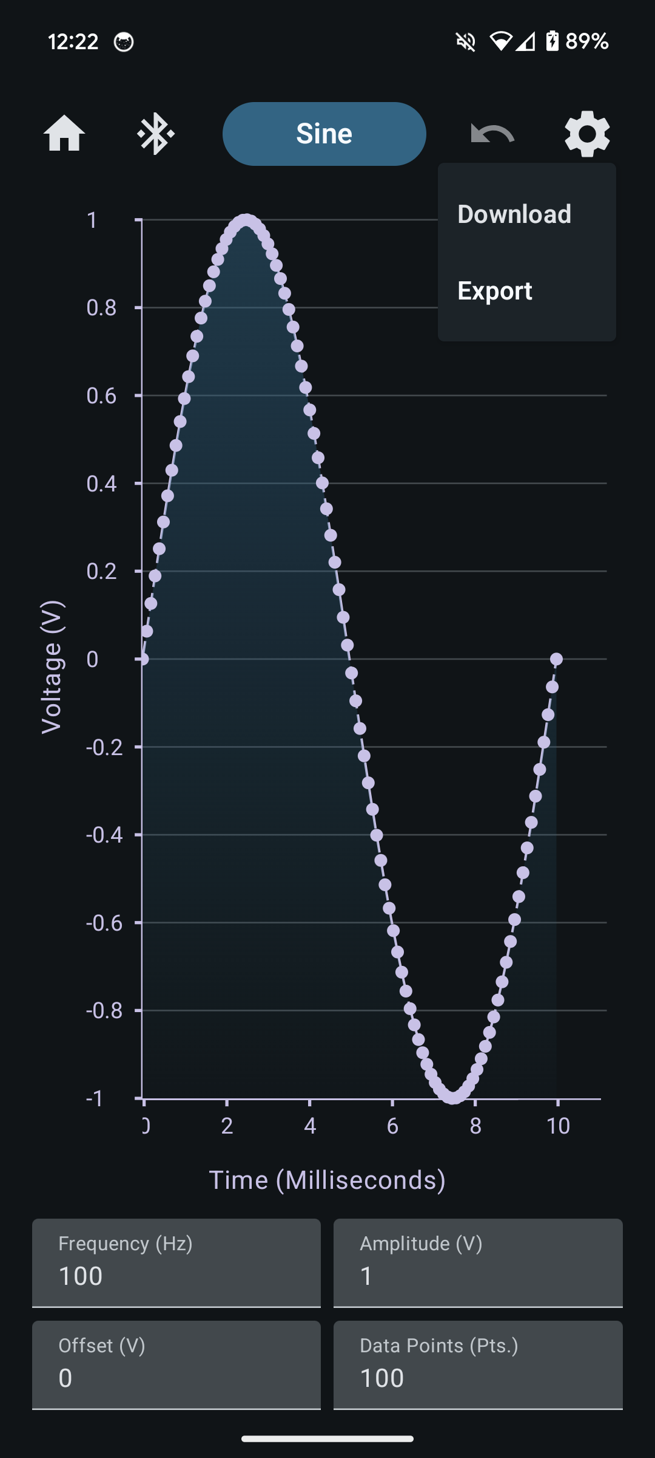
Android Application
Home Screen | Scanning | Connection | Freehand | Graphs
Notes:
Leandro **30 Seconds**
This should all be test results! – show things working, functional test results, error checking, etc
Show test results for integrated systems

Slide 7
MCU
Accomplishments since last update 12 hrs of effort | Ongoing progress/problems and plans until the next presentation
New board delivered, soldered, and functioning Full Bluetooth functionality Reads and writes all data points consistently, and time step value IDC cables ordered and delivered to connect to FPGA | Integration with FPGA testing
Notes:
This should not be just subsystem status!
At this point it should be review of the System Integration and Test activities led by Team Member 2
-For 4th review Accomplishments should include what integration and functional/range/error system testing completed and planned for next 2 weeks”
“Completed integration of all subsystems”
“Verified sensor data capture and communication through Bluetooth to App”
“Integrated image detection model on Pi-4 on drone, tested detection accuracy”
“Tested app error handling for stuck valve & thermal range exceeded cases”
“ON-GOING automated software testing”
“Range testing of LoRa network from 10m to 5km with 35 points in BCS”
“Rover motor stall test with 2x max payload and 40º elevation by next review”

Slide 8
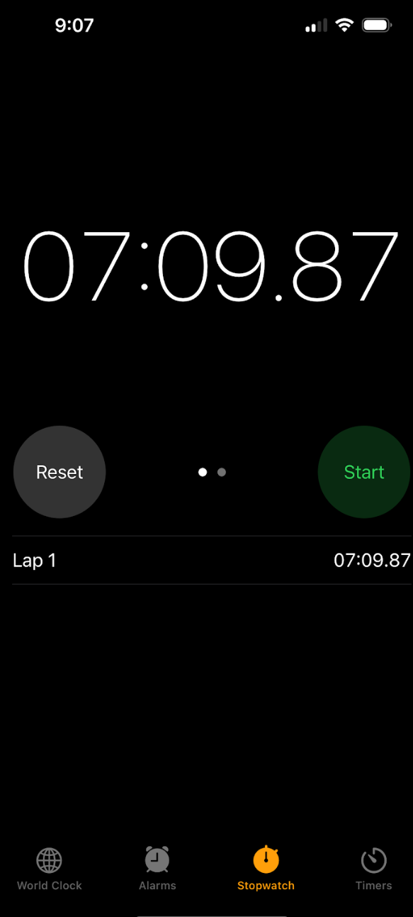
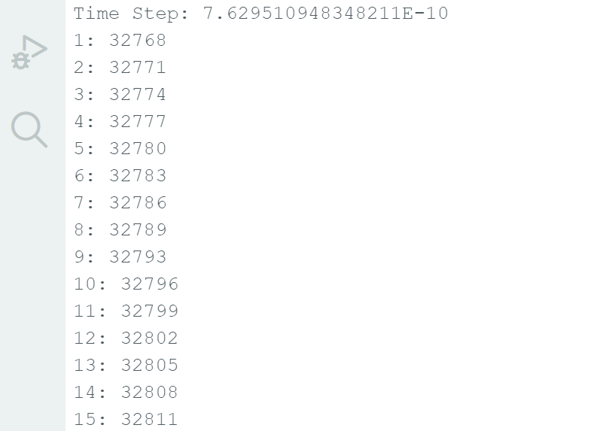
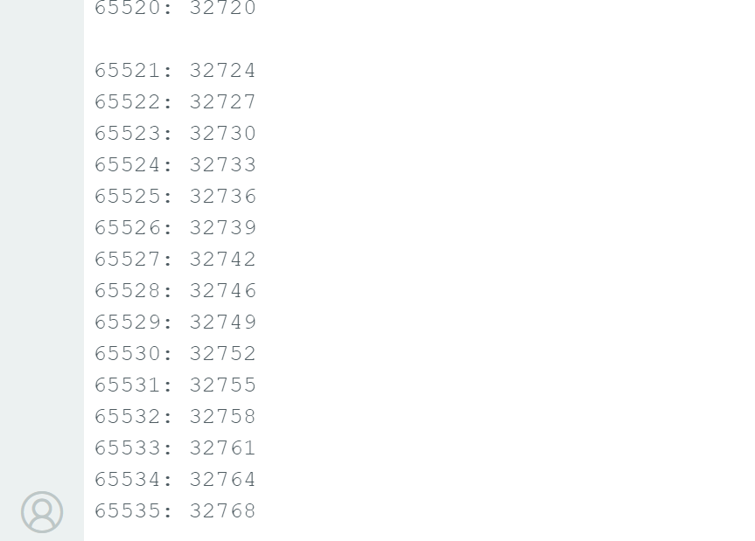
MCU
Beginning & End of Data Transfer
Total Time to Transfer

Slide 9
FPGA
Accomplishments since last update 30 hrs of effort | Ongoing progress/problems and plans until the next presentation
Coding the FPGA Partial soldering of the board | Integration with the MCU and DAC Have a working board

Slide 10
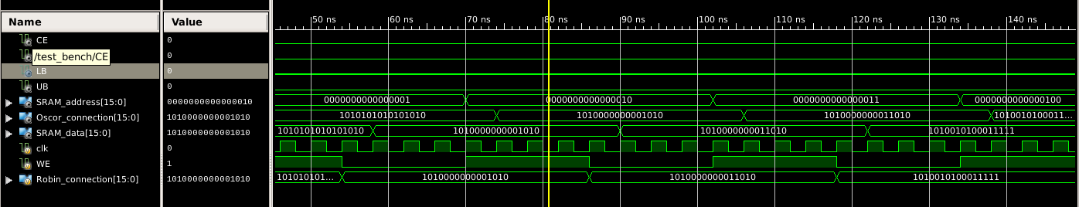
FPGA

Slide 11
DAC & Power System
Accomplishments since last update 8 hrs of effort | Ongoing progress/problems and plans until the next presentation
DAC board is soldered Power System board is soldered | Jump the power jack to the PCB because of hole size issue Finish up on tests Continue integration

Slide 12
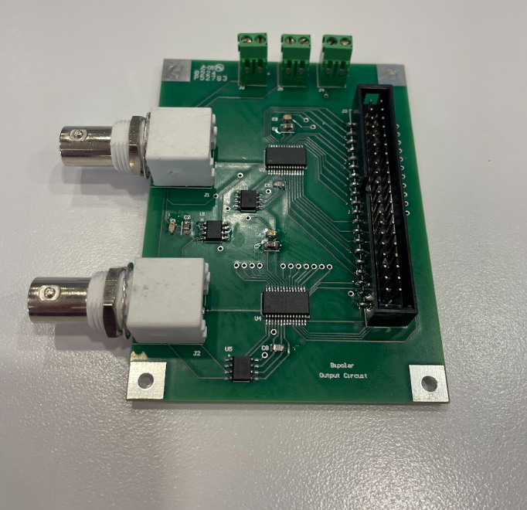
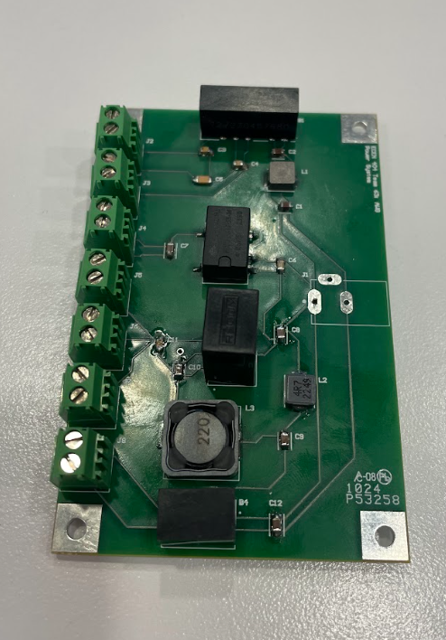
DAC & Power System
DAC Circuitry PCB
Power System PCB

Slide 13
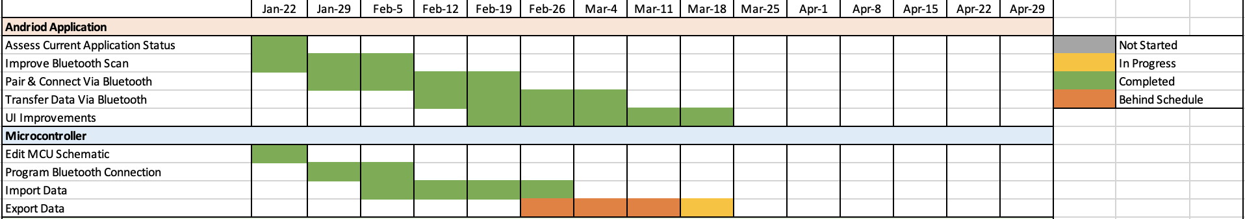
Execution Plan
Notes:
Execution plan
Your team planned milestones for completion of any remaining integration, functional, range, and error test, and validation plans should be presented.
Milestones should have owners … system tests, and full system integration can be group owned
Engineering milestones only [presentation, demo, document due dates are project milestone that do not belong on this chart]
Gantt chart.
DO NOT try to discuss all milestones in the plan – just high priority present and next engineering milestones

Slide 14
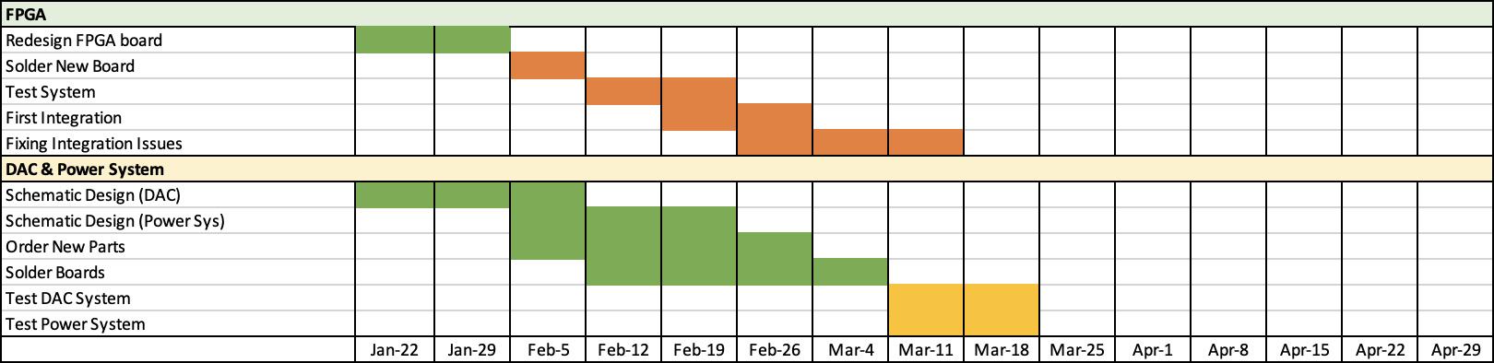
Execution Plan
Notes:
Execution plan
Your team planned milestones for completion of any remaining integration, functional, range, and error test, and validation plans should be presented.
Milestones should have owners … system tests, and full system integration can be group owned
Engineering milestones only [presentation, demo, document due dates are project milestone that do not belong on this chart]
Gantt chart.
DO NOT try to discuss all milestones in the plan – just high priority present and next engineering milestones

Slide 15
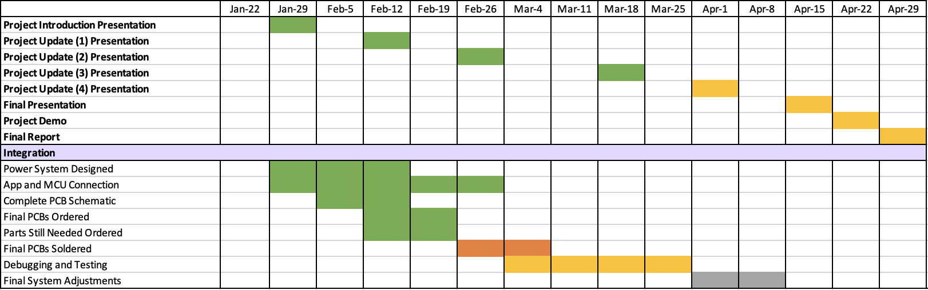
Execution Plan
Notes:
Execution plan
Your team planned milestones for completion of any remaining integration, functional, range, and error test, and validation plans should be presented.
Milestones should have owners … system tests, and full system integration can be group owned
Engineering milestones only [presentation, demo, document due dates are project milestone that do not belong on this chart]
Gantt chart.
DO NOT try to discuss all milestones in the plan – just high priority present and next engineering milestones

Slide 16
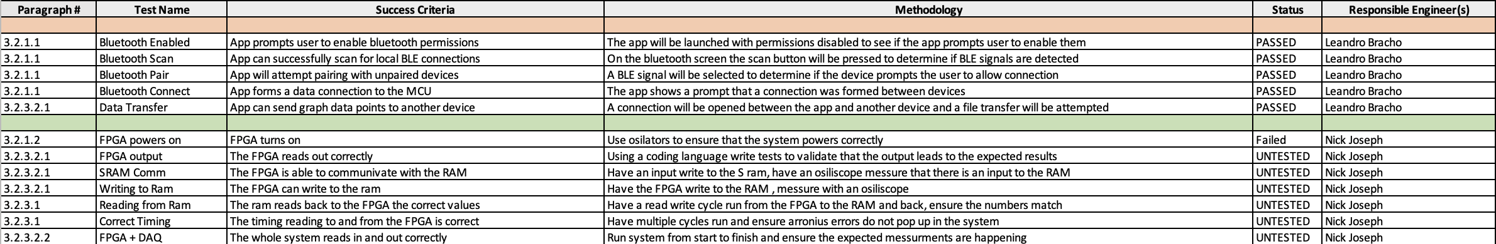
Validation Plan
Notes:
Validation plan
This is not a gantt chart.
Validation plan is a table showing:
Name: descriptive short description of what is being validated,
Requirement: Identifer to link to requirement # from conops/fsr/icd
Success Criteria for validation – range/lifetime/performance metric/physical limit…that must be met.
Methodology – test procedure followed/observations made/simulations completed/.. to satisfy the validation
Responsible party
Status – complete/not complete

Slide 17
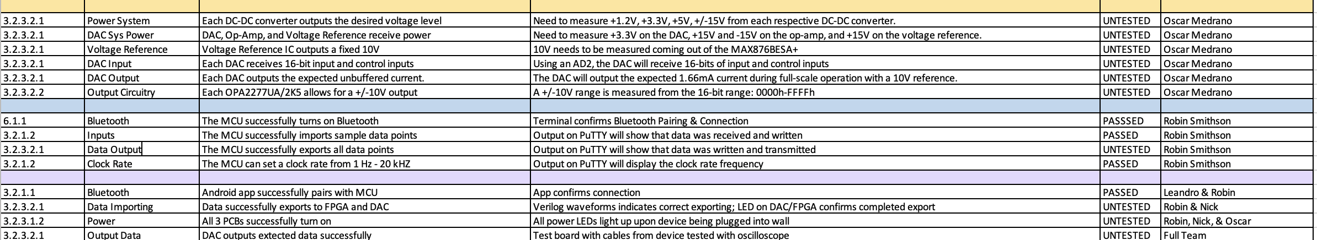
Validation Plan
Notes:
Validation plan
This is not a gantt chart.
Validation plan is a table showing:
Name: descriptive short description of what is being validated,
Requirement: Identifer to link to requirement # from conops/fsr/icd
Success Criteria for validation – range/lifetime/performance metric/physical limit…that must be met.
Methodology – test procedure followed/observations made/simulations completed/.. to satisfy the validation
Responsible party
Status – complete/not complete

Slide 18
Thank you

